Slide 1
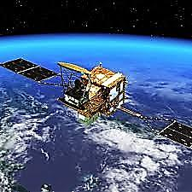
SATELLITE

Slide 2
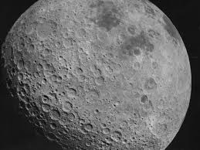
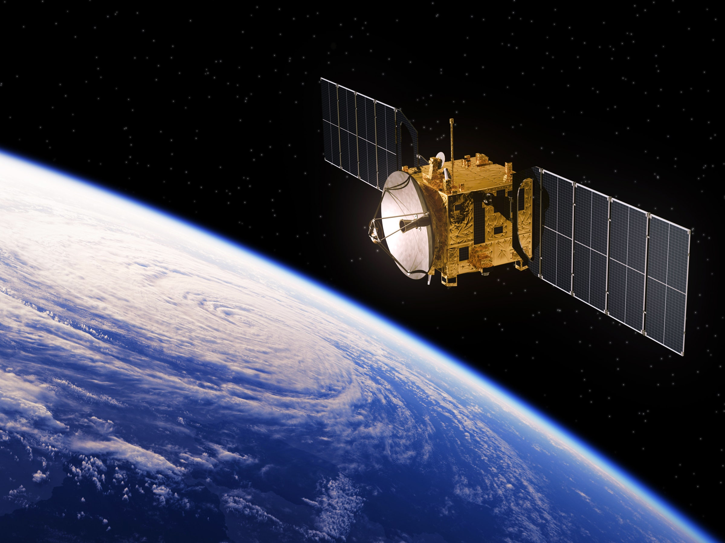
Definition :
A satellite is an object in space that orbits or circles around a bigger object under gravity
Types of satellites
Natural satellites
Artificial satellites

Slide 3
Natural satellite

Slide 4
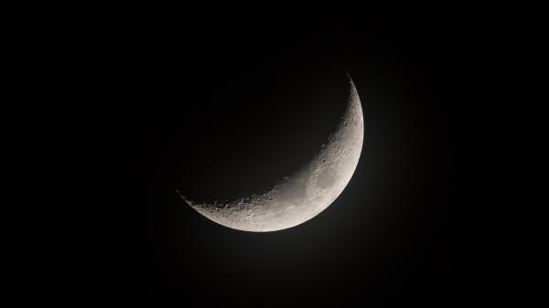
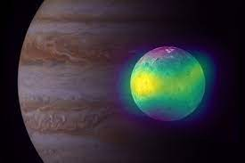
NATURAL SATELLITE (MOON)
Moon is our natural satellite. At about one-quarter the diameter of Earth , it is the fifth largest satellite in the Solar System, the largest satellite in the Solar System relative to its major planet, and larger than any known dwarf planet. The Moon is a planetary-mass object that formed a differentiated rocky body, making it a satellite planet under the geophysical definitions of the term. It lacks any significant atmosphere, hydrosphere, or magnetic field. Its surface gravity is about one-sixth of Earth's (0.1654 g). Jupiter's moon Io is the only satellite in the Solar System known to have a higher surface gravity and density.

Slide 5
Significance of The Moon
It is the cause of the rise and fall of the tides.
Moon is responsible for maintaining stable the climate of our planet
Due to absence of atmosphere, it is victim of all the cosmic influx from sun and distant star. This is the reason moon exploration is very important

Slide 6
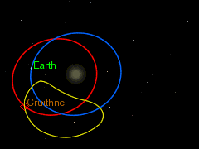
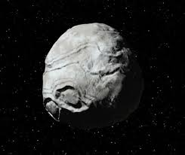
3753 Cruithne
As recently as 1997, we discovered that another body, 3753 Cruithne, is what’s called a quasi-orbital satellite of Earth. This simply means that Cruithne doesn’t loop around the Earth in a nice ellipse in the same way as the moon, or indeed the artificial satellites we loft into orbit. Instead, Cruithne scuttles around the inner solar system in what’s called a “horseshoe” orbit

Slide 7
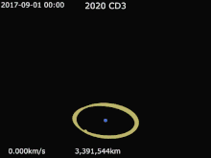
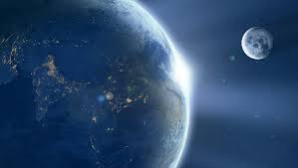

2020 CD₃
2020 CD₃ is a tiny near-Earth asteroid(or minimoon) that ordinarily orbits the Sun but makes close approaches to the Earth–Moon system, in which it can temporarily enter Earth orbit through temporary satellite capture (TSC). It was discovered at the Mount Lemmon Observatory on 15 February 2020, as part of the Mount Lemmon Survey or Catalina Sky Survey. The asteroid's discovery was announced by the Minor Planet Center on 25 February 2020, after subsequent observations have confirmed that it was orbiting Earth.

Slide 8
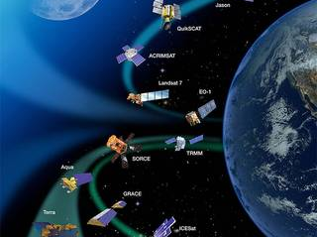
Artificial satellites

Slide 9
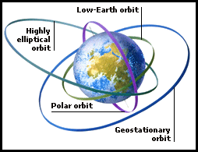
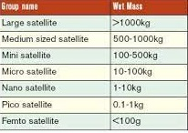
Artificial satellites
Classification can be done In many ways
On basis of altitude and shape of orbit
  LEO(low earth orbit), MEO (medium earth orbit),GEO(geostationary earth orbit),HEO(highly elliptical orbit) , polar orbit
On basis of weight of payload
  Nano, Pico , femto ,micro, mini or small, medium ,large

Slide 10
Artificial satellites
On basis of use
  Communication satellite like GSAT, INSAT
  Navigation satellite like NAVIC, INRSS
  Specific purpose satellite like RESOURSESAT,CARTOSAT, WHEATERSAT
  Educational satellite like EDUSAT
  Defence satellite like DSCS, GSAT 7

Slide 11
Artificial satellites
Some facts about Artificial satellites
They are in state of constant free fall
There are more than 2500 artificial satellite around earth
Any wear and tear in satellite can cause serious damage as each fragment is moving with such high speed.
7 navigation satellites are required to completely map earth
India currently hold record of sending 104 satellite in one go. (US-{88 Doves from Planet Inc , 8 nanos from LEMUR}, NETHERLANDS- PEASSS, SWITZERLAND- DIDO-2, ISRAEL- BGUSat, KAZHAKSTAN- Al-Farabi-1, UAE- Nayif-1, INDIA - INS-1A INS-1B, CARTOSAT-2)
Satellites travel at 18,000 miles per hour. That means in a given day, satellites can travel the entire circumference of the Earth about 14 times.

Slide 12
Artificial satellites
In October 1957, the Soviet Union launched Sputnik 1 which was the world's first artificial satellite to be sent into space orbit.
Sputnik 2, launched in November 1957, carried the first living creature into orbit, a dog named Laika.
Just three months after the Soviet Unions first successful satellite launch, the USA launched its first satellite, Explorer 1, in January 1958.
The International Space Station (ISS) is the largest artificial satellite currently orbiting Earth.
A geostationary satellite orbits Earth from west to east over the equator. It moves in the same direction and speed as Earth is spinning, therefore from Earth, these satellites don't appear to be moving.
Polar-orbiting satellites orbit Earth in a north-south direction from pole to pole, so as Earth spins underneath, these satellites scan the entire globe strip by strip.

Slide 13
Artificial satellites
The two main components of an artificial satellite is an antenna to send and receive information and a power source such as a solar panel or battery.
The speed a satellite must travel to stay in space is called its orbital velocity. It usually needs to be more than 17,500 mph (28,200 km/h).
Space debris can be anything from large obsolete satellites to natural or artificial fragments of space materials. Since 1957, the Space Surveillance Network SSN has tracked more than 26,000 objects above 10 cm in diameter.
As more satellites are launched the chances of a crash increases, in 2009, two communications satellites - one American and one Russian - collided in space

Slide 14
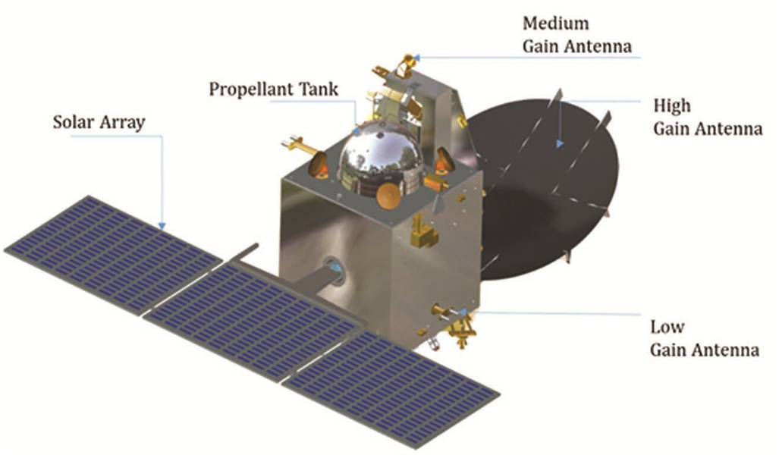
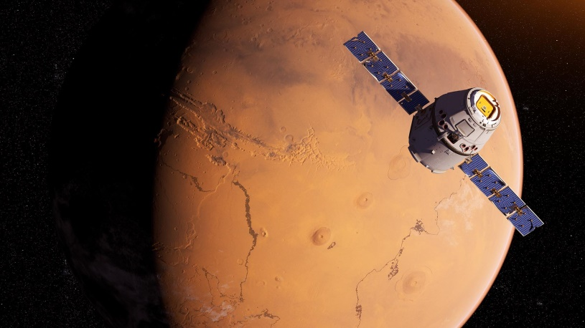
Mangalyaan
The Mars Orbiter Mission (MOM), also called Mangalyaan, is India’s first interplanetary mission to the planet Mars. India becomes the first country in the world to insert a spacecraft into the Martian orbit in its very first attempt, if went successful. Indian Space Research Organisation (ISRO) becomes the fourth space agency to reach Mars after Roscosmos, NASA and ESA. MOM is the cheapest and lowest-cost inter-planetary mission ever to be undertaken in the world The project was approved by the government of India on 3 August 2012 and costs Rs. 450 crores.

Slide 15
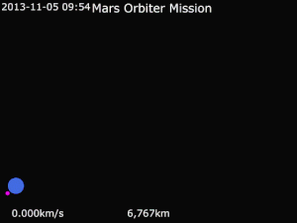
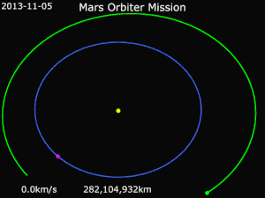
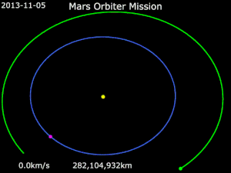

Mangalyaan

Slide 16
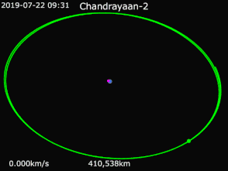
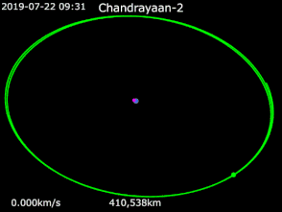
Chandrayaan 2

Slide 17
Data and photo credit
en.wikipedia.org
www.quora.com
blog.blogspot.com
Isro.gov.in
Nasa.gov

